Slide 1
Liquor Distribution by Country
Jacob Fabian

Slide 2
How Much Beer, Wine, and Spirits
USA, Canada, Mexico, Panama, and Bahamas all need beer, wine and spirits delivered to each county.
Looking at how much alcohol is consumed by each country can lead us to know how much needs to be sent

Slide 3
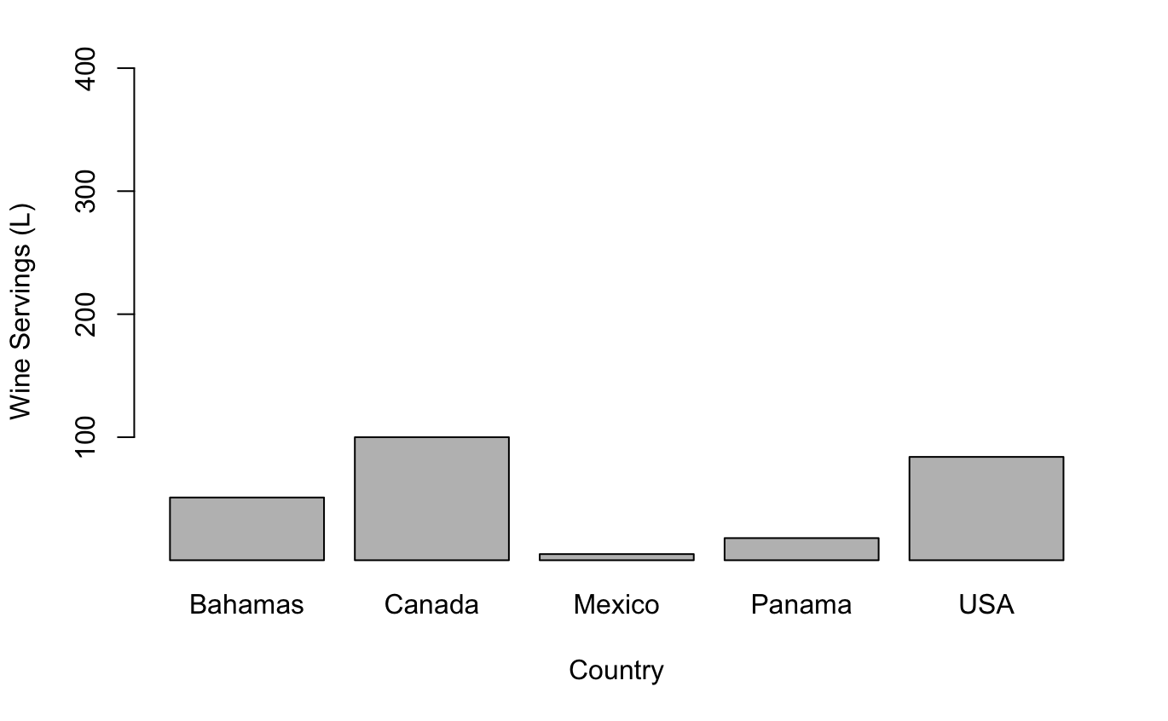
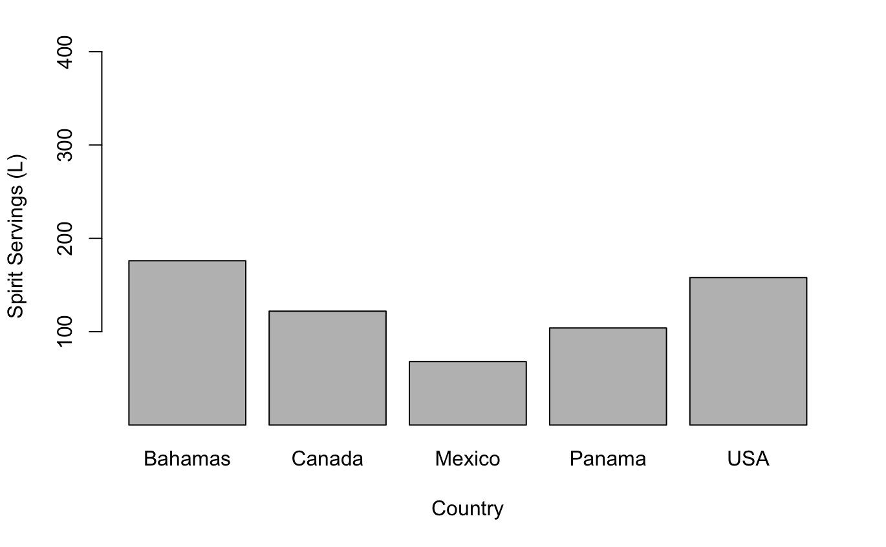
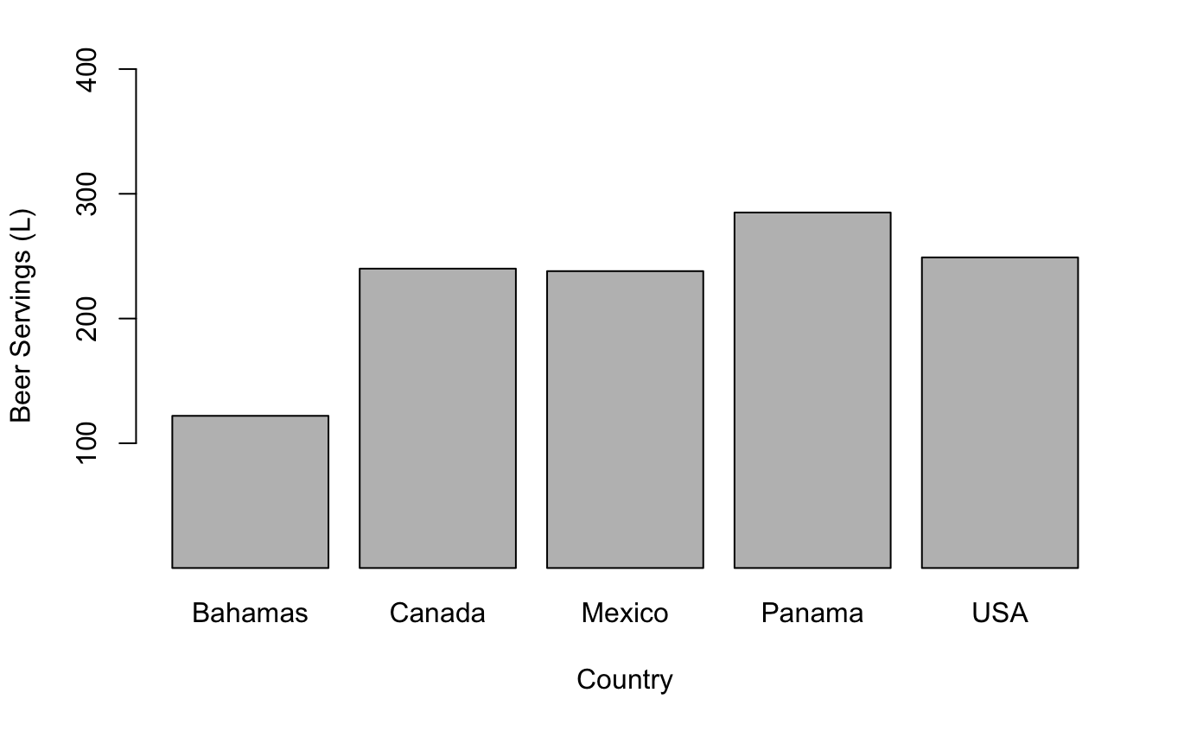
Wine, Spirit, and Beer Consumption by Country

Slide 4
Results
Beer is the most widely consumed alcohol
Spirits are the second most popularly consumed alcoholic beverage with the majority consumed in the Bahamas, United States and Canada
Wine is the least consumed alcohol with the majority consumed in the United States and Canada
United States – Beer - 50.7% Spirits - 32.2% Wine – 17.1%
Panama – Beer – 70% Spirits - 25.6% Wine – 4.4%
Mexico – Beer - 76.5% Spirits – 21.9% Wine – 1.6%
Canada – Beer – 51.9% Spirits – 26.4% Wine – 21.6%
Bahamas – Beer - 35% Spirits – 50.4% Wine – 14.6%

